Slide 1
Trends in the Periodic Table

Slide 2
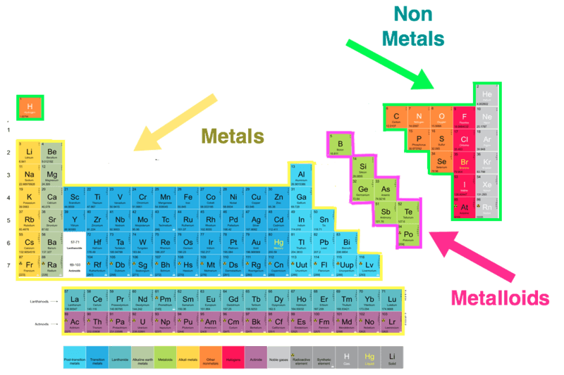
The periodic table is divided into three categories:
The metals on the left.
The non-metals on the right (plus hydrogen).
The metalloids on the border between metals and non-metals.

Slide 3
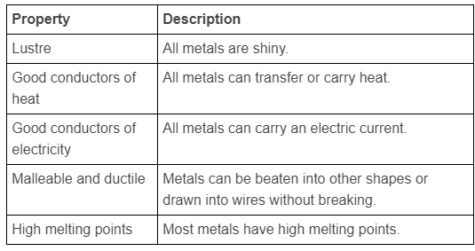
Metals make up most of the periodic table, 91 of the current 118 known elements are metals!
Metals all have the following properties:

Slide 4
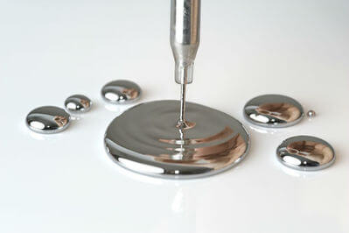
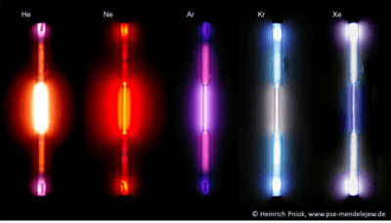
Though there are considerably fewer non-metals than metals, they have considerably more variation.
For example, there is only 1 metal which is not a solid (mercury, which is a liquid). In the non-metals there are 11 gases, 5 solids and 1 liquid.

Slide 5
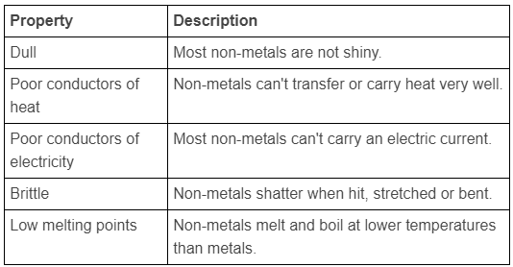
In contrast to metals, non-metals have the following properties:

Slide 6
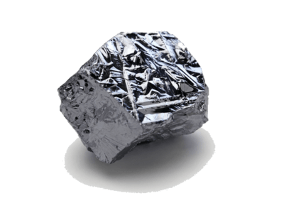
Metalloids (sometimes called semi-metals) have similar properties to both metals and non-metals.
They tend to look more like metals, but act more like non-metals.
For example, silicon is shiny, but also brittle and only a semiconductor (will conduct electricity under certain circumstances).

Slide 7
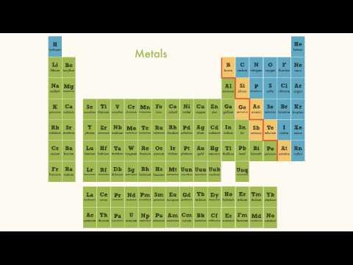

Slide 8
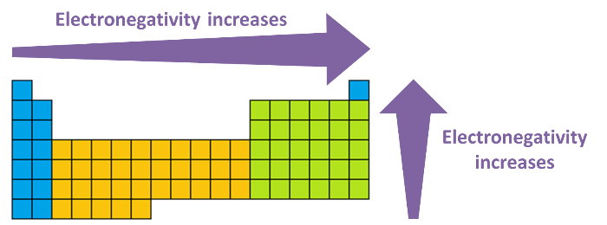
Electronegativity is a measure of how strongly an atom attracts electrons.
Electronegativity increases as you go to the right of the table, and as you go up the table.

Slide 9
The electronegativity affects how an element will react.
An element with a high electronegativity, such as oxygen, is going to be very good at taking electrons.
An element with a low electronegativity, such as caesium, is going to be very good at losing electrons.

Slide 10
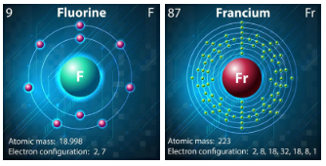
Fluorine is the most electronegative element.
Francium is the least electronegative element.

Slide 11
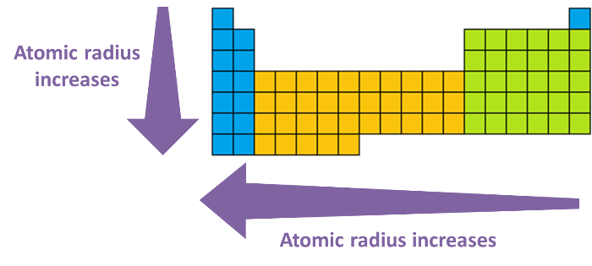
The atomic radius is the distance from the nucleus to the outer electrons.
Atomic radius increases as you move to the left of the table, and as you go down the table.

Slide 12
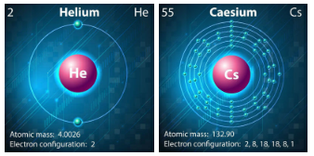
Helium has the lowest atomic radius.
Caesium has the highest known atomic radius.

Slide 13
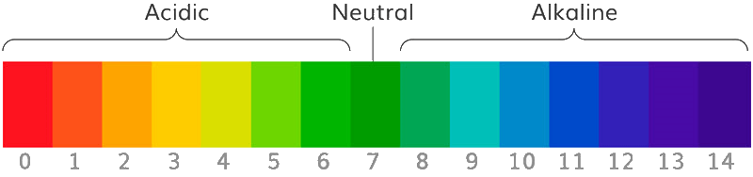
Due to the patterns in atomic structure and properties, there are also some trends seen in the compounds formed.
An example is the oxides of the elements, which change from basic through amphoteric to acidic across a period.
The alkali metals (group 1), as their name suggests, form strongly basic oxides. As you move across the periodic table to the non-metals, such as carbon, nitrogen, sulphur and fluorine, the oxides become acidic. (Again hydrogen is an exception, being placed above group 1, but forming a neutral oxide, H_{2​}O.)

